Slide 1
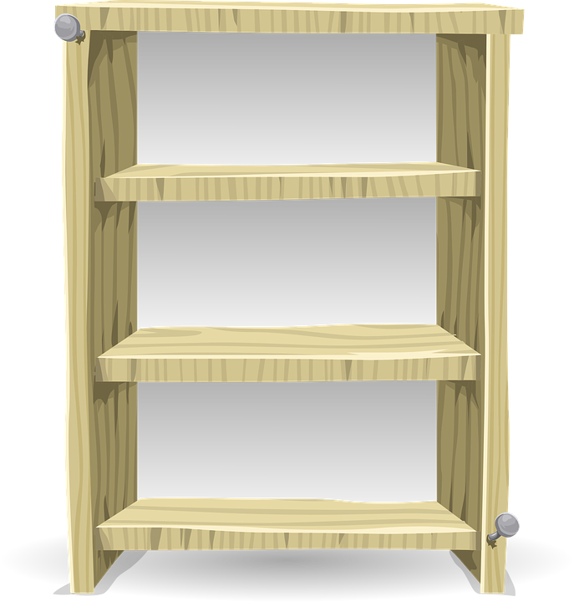
Welcome to Third Grade
Wilkinson Gardens Elementary School
Dr Kathleen Mainhart
Syllabus
Wildcats ROAR
School Calendar
Click on me to find out more about me.

Slide 2
All About Me
Hello Third Graders and Parents,
My name is Dr. Mainhart and this is my fifth year teaching at Wilkinson Gardens Elementary School in Georgia. I am very excited to be your teacher this year. We will learn lots of wonderful things.
I graduated in 1985 from Goucher College with a BA in Elementary Education and English. I spent two years as a Peace Corps Volunteer in Morocco and when I returned to the United States, I taught in New Hampshire and Virginia. While in Virginia, I attended the University of Virginia and got my M.Ed and Ph.D in Educational Evaluation. My research involved looking at how experienced teachers incorporated multicultural education into their classroom. Since then I have taught in New York City (both elementary and graduate education) and in the United Arab Emirates.
I am pleased to be in Georgia and to be teaching grade 1 at Wilkinson Gardens.

Slide 3
3rd Grade Syllabus
ELA
• Phonics: Sight words, homophones, schwa sound, vowel teams, suffixes, syllable types
• Grammar: (nouns, verbs, adjectives, conjunctions, etc.)
• Writing: Personal Narrative, Opinion, Informational Text
• Reading: Read and identify different kinds of texts (informational and literary)
Social Studies
Geography: Major Rivers and Mountain Ranges
13 Colonies become the United States
Westward and Expansion; Native Americans

Slide 4
Supply List
Ear buds or Headphones
2 spiral 1 subject notebooks, college ruled (blue, green)
2 composition notebooks, college ruled
(blue, green)
4 pocket folders (no prongs) (2 blue, 2 green)
Wooden Pencils
Pencil box OR large pencil pouch
4 highlighters
2 packs of glue sticks
Scissors
1 pack 24 count crayons
1 pack-colored pencils
2 packs of college ruled lined paper
Tissue
Hand Sanitizer
Dry erase markers (for student use)
Homeroom Wishlist (for classroom use)
-White copy paper
-Multi-color copy paper
-White card stock
-Multi-color card stock
-Band-aids
-Sanitizing wipes
-Baby wipes

Slide 5
Roaring Behavior
R.O.A.R. | Classroom Voice Level 1
R Respectful to others | Raise your hand Take turns Be kind to others Keep hands, feet, and objects to yourself
O Orderly at all times | Use classroom manners Keep your area neat Listen to your teacher No running or horse playing
A Always Putting Safety First | Maintain self-control Listen and follow directions Ask before leaving your seat Report any problems to the teacher
R Ready for success | Try your best Participate Learn and follow classroom expectations

